Slide 1
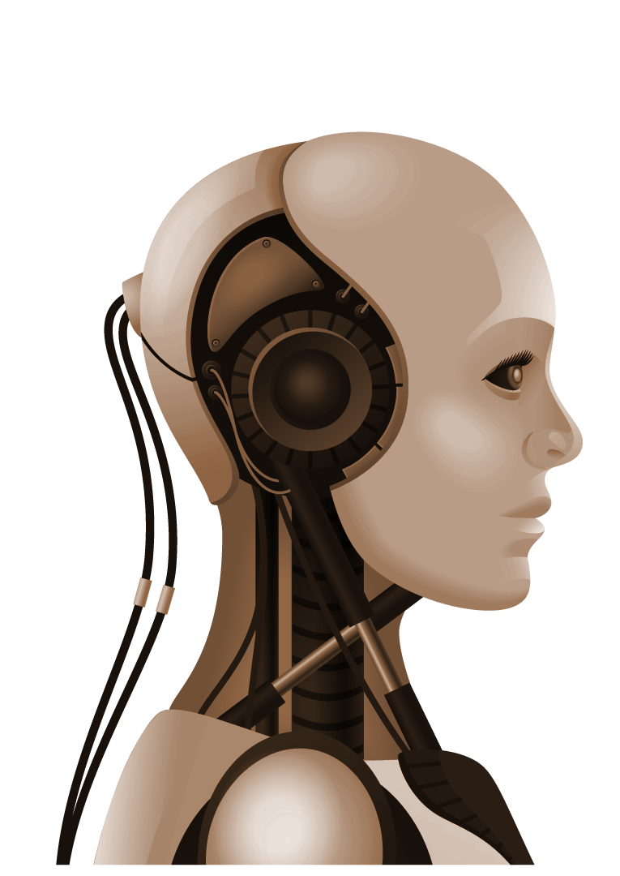

Sarcasm Detection NLP
Bryan Dunleavy & Tahora Husaini
Notes:
Bryan: One sentence intro. Our project involves detecting sarcasm with the help of two NLP based machine learning models.

Slide 2
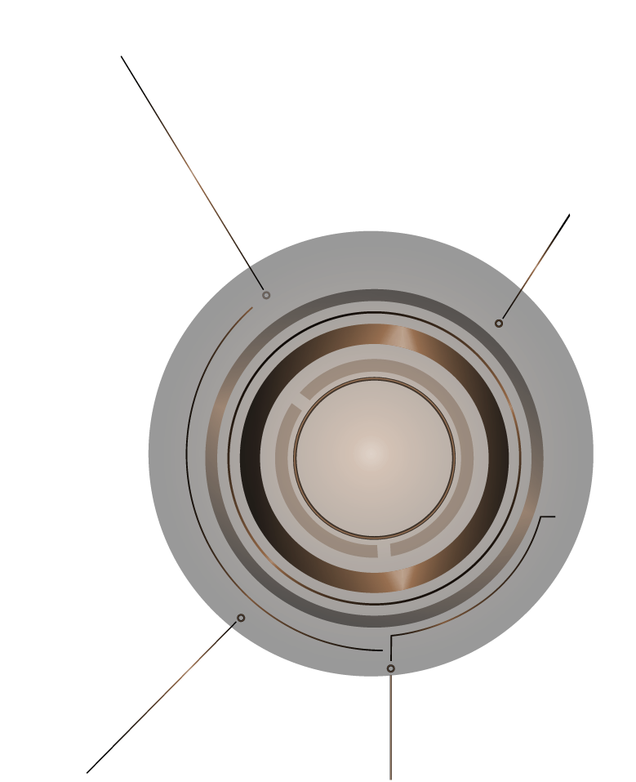

What is Sarcasm?
?
⏩Nuanced form of language
⏩Characterized by incongruity
⏩Mostly conveys negative sentiment
⏩Ridicules, critiques,insults

Slide 3

The importance of sarcasm detection
Statista: 93% 0f Internet users are on Social Media. An ever increasing percentage of content consumed online is unedited, unregulated and thus open to misinterpretation.
 | Social, political and economical Impact
 | Business/Product Analysis
 | Behaviour Analysis (pandemic, election, war, recession)
 | Content moderation (terrorism, hate speech, bullying, extremism)
Notes:
60% of the world’s population use social media platforms resulting in a gigantic amount of unregulated and unedited content being consumed and created.
The ability in real-time to accurately detect the sentiment of content, professional or otherwise, can greatly impact social, political and economic spheres.

Slide 4

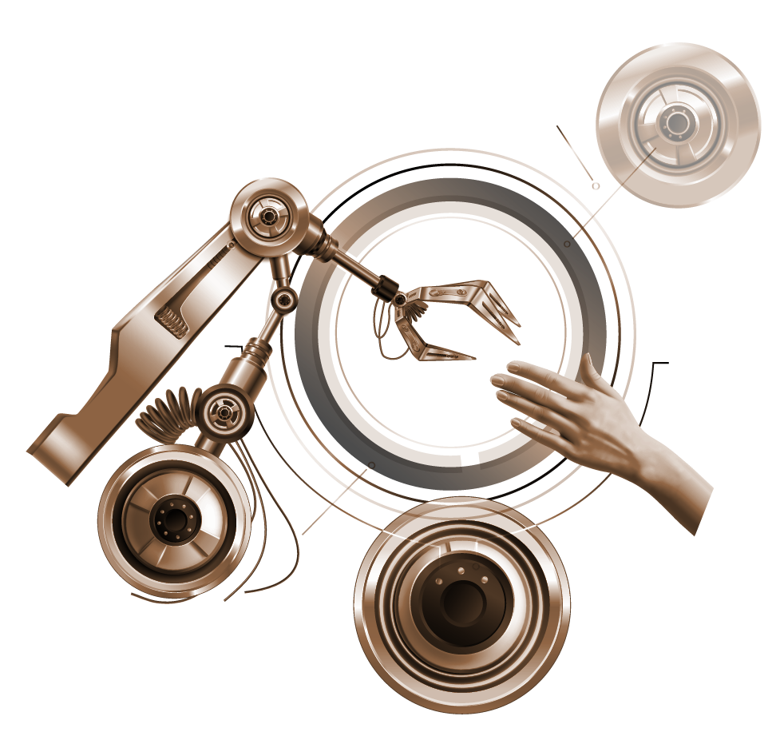
Let‘s detect some sarcasms!
“I loved having to wait 5 hours to see a doctor”
“I love commuting to work”
"Oh, great, another Monday! I just can't contain my excitement..."
Notes:
Often characterised by the presence of a positive verb contrasted with a negative sentiment.
Without context or further indicators such as tonality and body language, isolated text examples can be hard to accurately detect.
Often, sarcasms can be overstated and contain superlative language.

Slide 5

Why is it difficult to detect Sarcasm in text?
01
04
02
05
03
06
Context Dependent
Cultural Differences
Ambiguity
Target
Figurative
Lack of Specialised Data
Notes:
As our comparison of different datasets will soon demonstrate, non self-contained sentences can be hard to decipher.
Sentences and expressions can have more than one meaning
Sarcasm’s can contain colorful, absurd language to prove a point.
It can be delivered and perceived differently in different cultures.
The object of sarcasm is not always explicit.
After two weeks after scouring the net for source data, we found limited datasets curated with sarcastic labels.

Slide 6
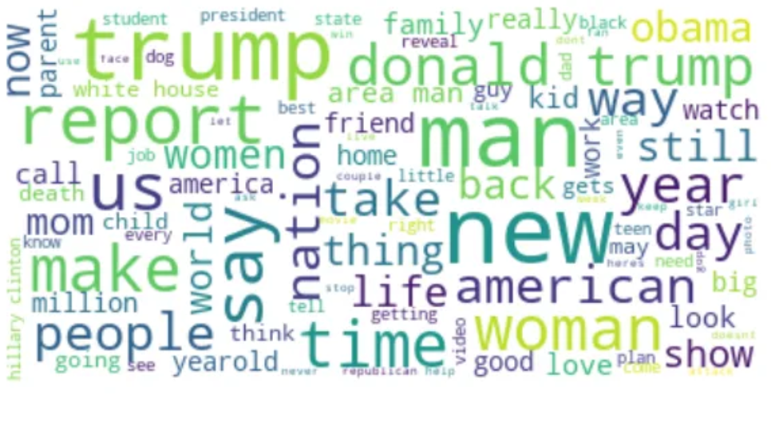

Slide 7


LSTM
Long Short Term Memory
Bidirectional
Reddit Sarcasm Data Set: 1.3 million entries
Sarcasm Headlines Data Set: 28000 entries
Notes:
Preprocessing: lower case, special characters, misspelling, performed tokenization, lemmatization and padded the sequences to ensure uniformity of length.
Embedding: We used pre-trained embeddings to represent the words as dense vectors.
Training: Adam optimizer with binary cross-entropy loss, we ran 5 epochs and used a batch size of 16.

Slide 8
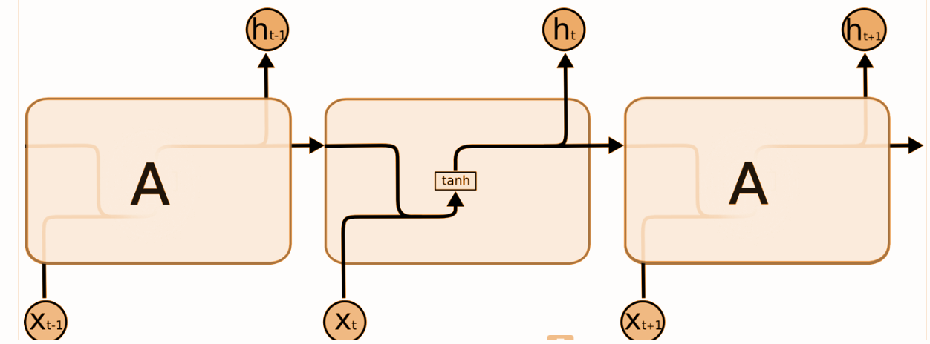
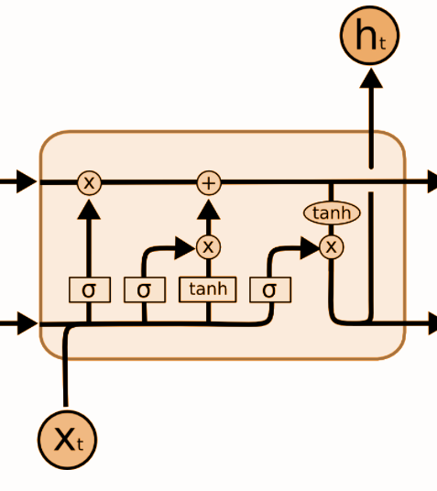
How LSTM works
R.N.N
Clouds are in the sky
I lived in France for 17 years and so I speak French
Cell State
L.S.T.M - Bidirectional
Forget Gate Layer
Input Gate Layer
Embedding Layer
Bidirectional LSTM Layer
GlobalMaxPooling 1d Layer
Two Density Layers with dropout
Output Layer
Trained on 2000000 word vectors with text scraped via Common Crawl
Hidden Layer
Tom eats pizza and pasta, his favorite cuisine is Italian.
Mary eats burgers and hotdogs, her favorite cuisine is American.
Notes:
Imagine reading a story. As you read each sentence, you try to understand it based on what you've read before. RNN works likes this – it processes data step-by-step while keeping track of previous information. Take the example: Clouds are in the sky. A simple single layer RNN would be able to complete the sentence by adding sky but lacks the ability to learn long term dependencies.
Word vectors capture semantic similarity, representing similar words closer together in space (e.g., "cat" and "dog" closer than "cat" and "apple"). They also provide contextual information, enabling the model to understand word meaning in various contexts, while offering dimensionality reduction and transferable knowledge for efficient NLP tasks.

Slide 9
Model Performance – L.S.T.M
R = Reddit Dataset
H = Headlines Dataset
Accuracy
Precision
Recall
F1
R - 72.62%
H -79.33 %
R - 73%
H - 78.4%
R - 71.94%
H - 78.2%
R - 72.47%
H - 78.3%
Headlines can be analysed in isolation.
Reddit comments are often responses
Headlines written professionally.
Reduces sparsity and increase the chance of finding pre - trained embeddings
Our data contains headlines from ‘The Onion’ which specialises in sarcastic news commentary hence the high quality labelling

Slide 10
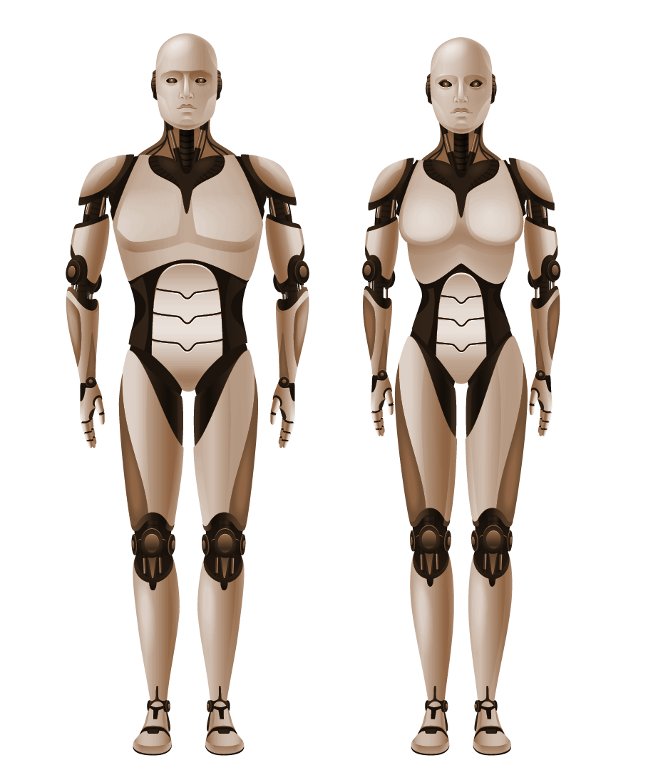


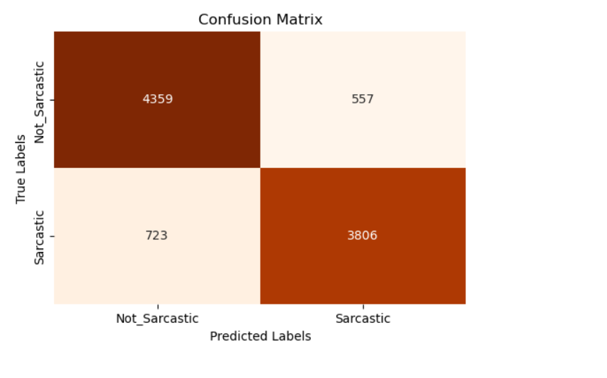
BERT Transformer
BERT was listed in 2018 as one of the most important milestones in transfer learning history.
Bidirectional
Context_aware word embeddings help it understand nuanced meanings
Relies on self-attention mechanism
Mask & Next sentence prediction

Slide 11
Model Performance –BERT (Headings Dataset)
Accuracy
Precision
Recall
F1
86%
86,5%
86,5%
86,5%

Slide 12
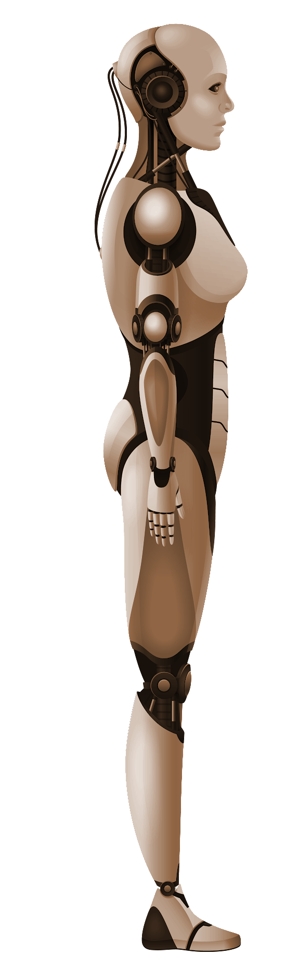
Conclusion
⏩Sarcasm is not easy to detect!
⏩Limited datasets are available globally.
⏩Larger corpora do not always lead to better results. Quality is key!
⏩BERT surpasses L.S.T.M in multiple areas: Less greedy, better at detecting deeper contextual information. Utilizes transfer learning.
⏩

Slide 13

Thanks!
We would “love” to answer your questions!
Model.predict ⏩Highly sarcastic sentence.

Slide 14


OUR TEAM
Bryan Dunleavy
Masters in Sarcasm
Tahora Husaini

